Slide 1

AWS WAF

Slide 2
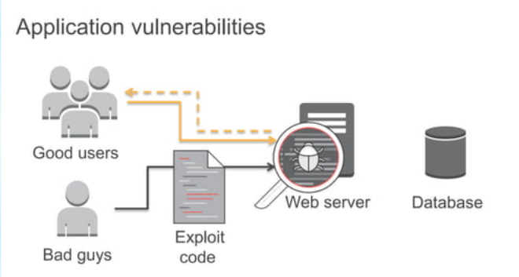
Common Web Attacks
SQL injections: SQL injection is a code injection procedure that might destroy your SQL database. Attackers can run malicious SQL queries on your web applications.

Slide 3
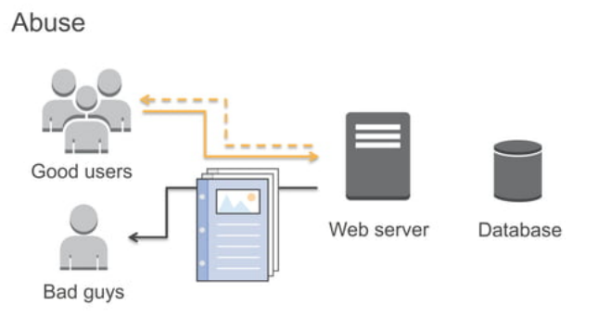
Cross-Site Scripting: If your application is vulnerable to cross-site scripting, then the attacker can run or inject malicious scripts, generally in the form of a browser side script. These scripts can even rewrite the content of the HTML pages.

Slide 4
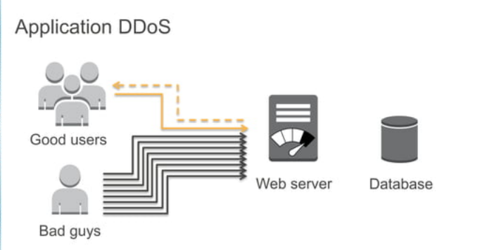
DDoS(Denial-Of-Service) attacks: This is probably the most common attack. Attackers overload an application by sending bulk requests to the web servers. Thousands of hosts infected with malware are used in this attack, which utilizes more than one unique IP address or machine. This slows down the application and significantly hurt the value of a brand.

Slide 5
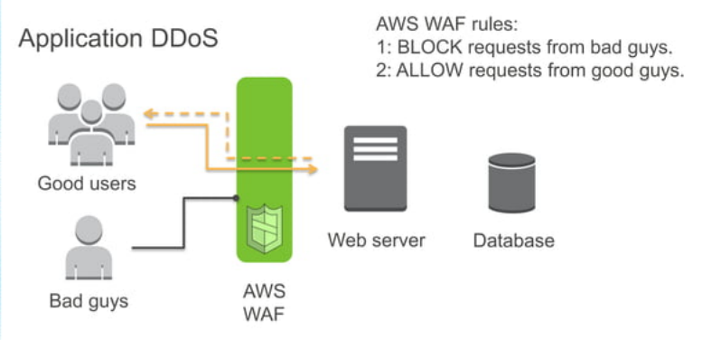
AWS Web Application Firewall (WAF) is a security tool that helps you to protect the application against web attacks. lets you monitor the HTTP(S) requests that are forwarded to your protected web application resources.
lets you control access to your content by using an IP address from where the request originates.

Slide 6
Features
Web traffic filtering : lets you create rules to filter web traffic based on conditions that include IP addresses, HTTP headers and body, or custom URIs.
Monitor Rules : Web Application Firewall AWS allows us to create rules and review and customize them to prevent unknown attracts.
Flexible Integration : offers easy integration with other AWS services like Amazon EC2, CloudFront, Load balancer etc.
Protection Against Web Attacks : With minimum latency impact on incoming traffic, WAF AWS offers many rules to inspect any element of a web request
Establish Rules Accordingly : it allows users to establish rules according to their needs and vulnerabilities that they wish to stop.

Slide 7
Benefits:
Additional protection against web attacks using criteria that you specify.
IP addresses, Country that requests originate from.
Values in request headers.
Strings that appear in requests, either specific strings or strings that match regular expression
Length of requests.
Presence of SQL code that is likely to be malicious (known as SQL injection).
Presence of a script that is likely to be malicious (known as cross-site scripting).
Rules that can allow, block, or count web requests that meet the specified criteria. Alternatively, rules can block or count web requests that not only meet the specified criteria, but also exceed a specified number of requests in any 5-minute period.
Rules that you can reuse for multiple web applications.
Real-time metrics and sampled web requests.

Slide 8
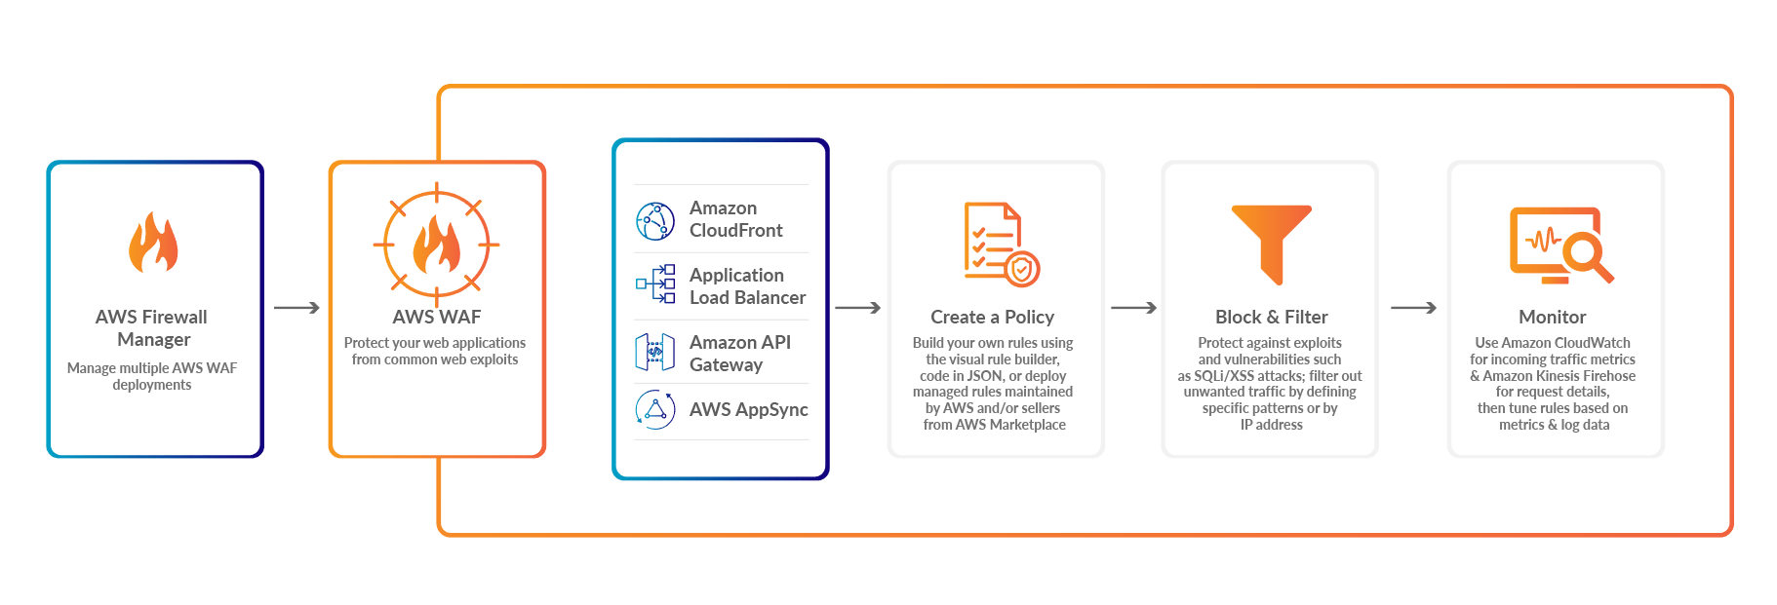
How It Works
AWS Firewall Manage : It Manages multiple AWS Web Application Firewall Deployments
AWS WAF : Protect deployed application from common web exploits.
Create a Policy : Now you can build your own rules using the visual rule builder.
Block Filter : Block filter protect against exploits and vulnerabilities attacks.
Monitor : Use Amazon CloudWatch for incoming traffic metrics

Slide 9
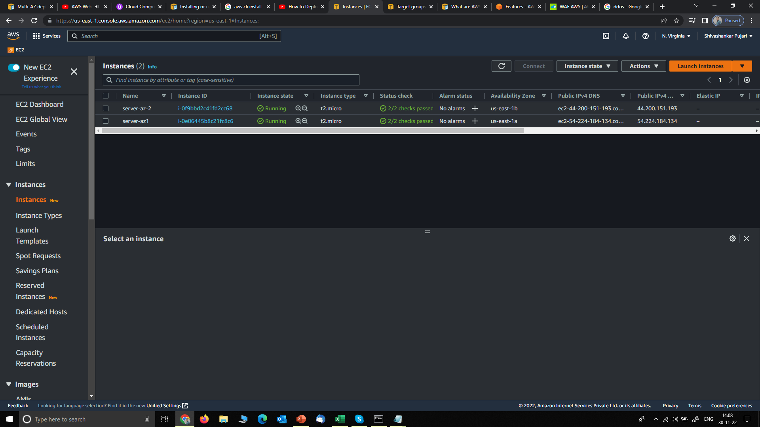
1. Create a Application Load Balancer, for that launch to instances in diff AZs

Slide 10
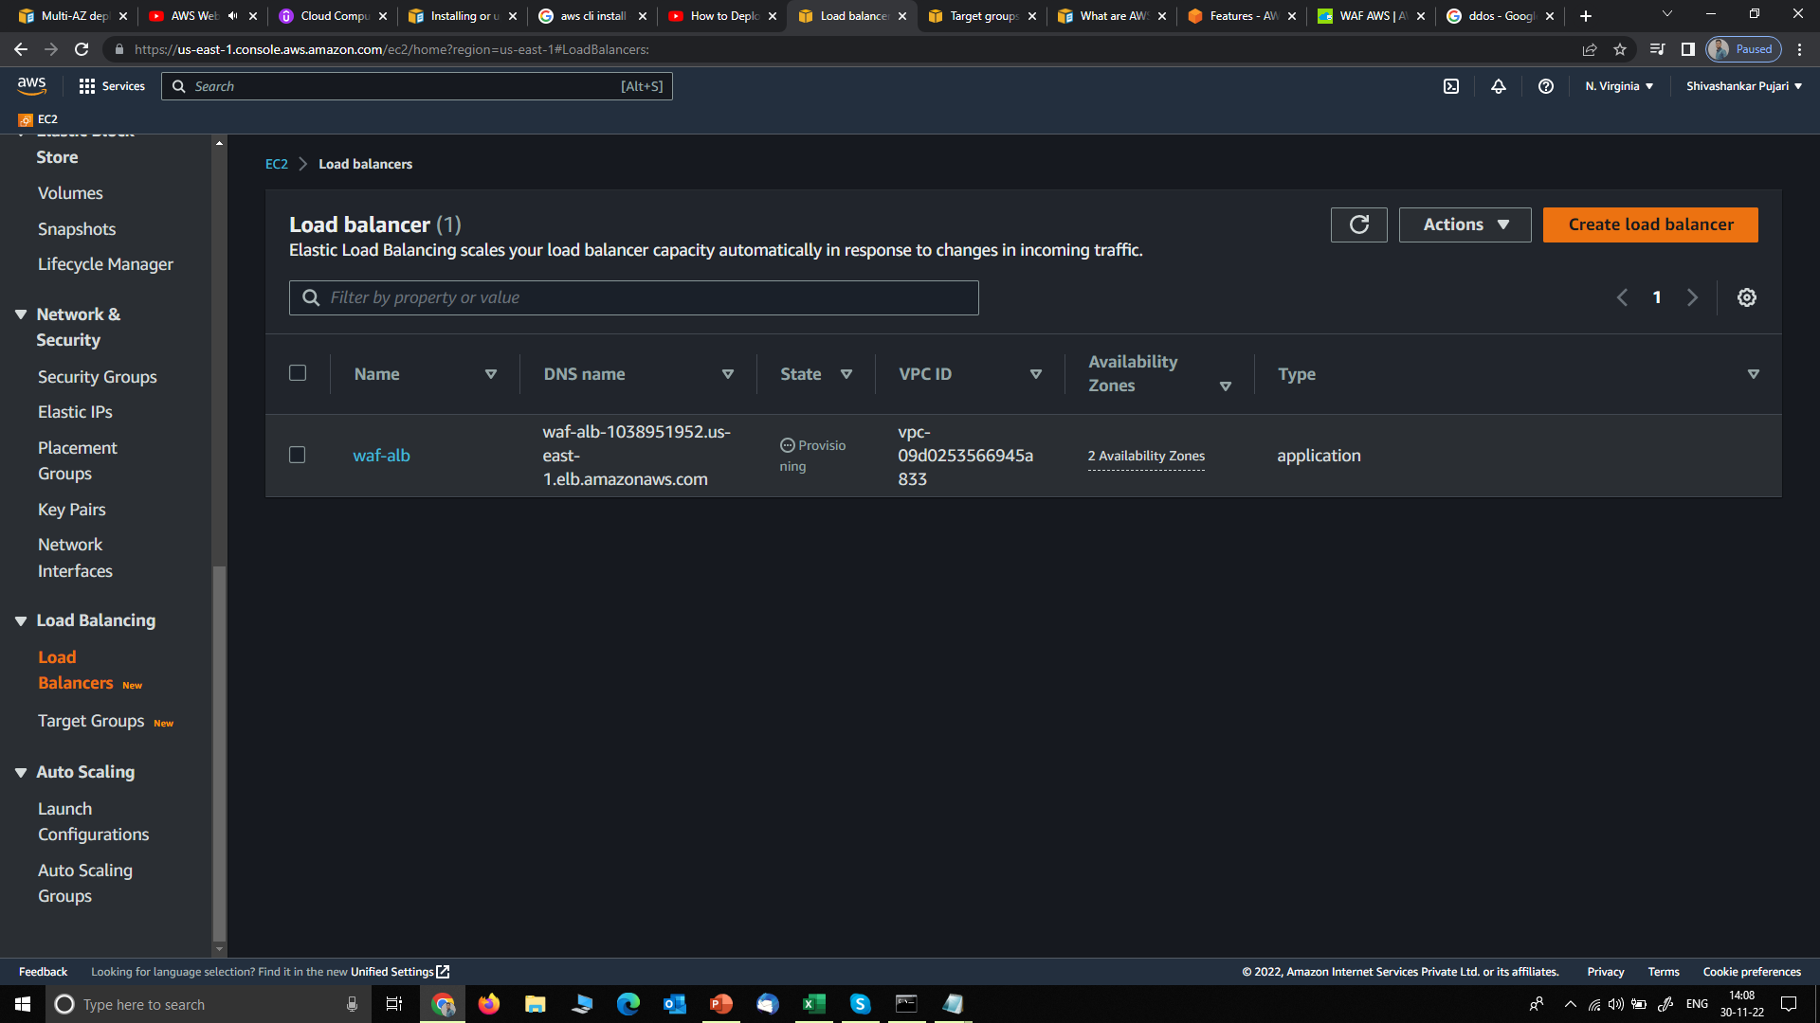
2. Created a Application Load Balancer

Slide 11
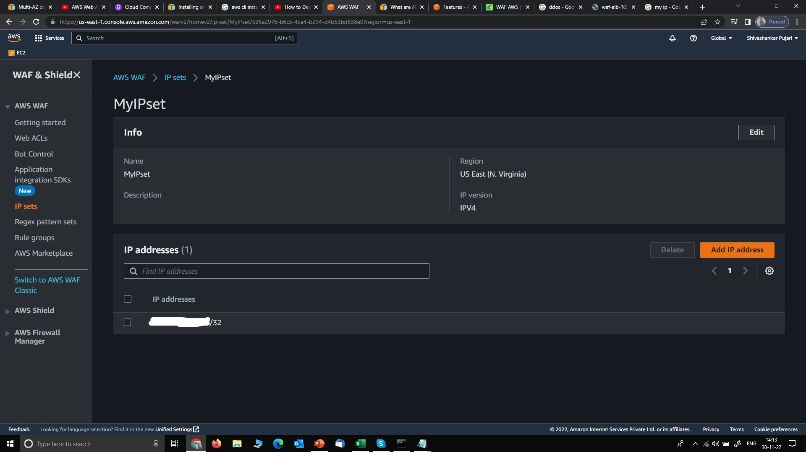
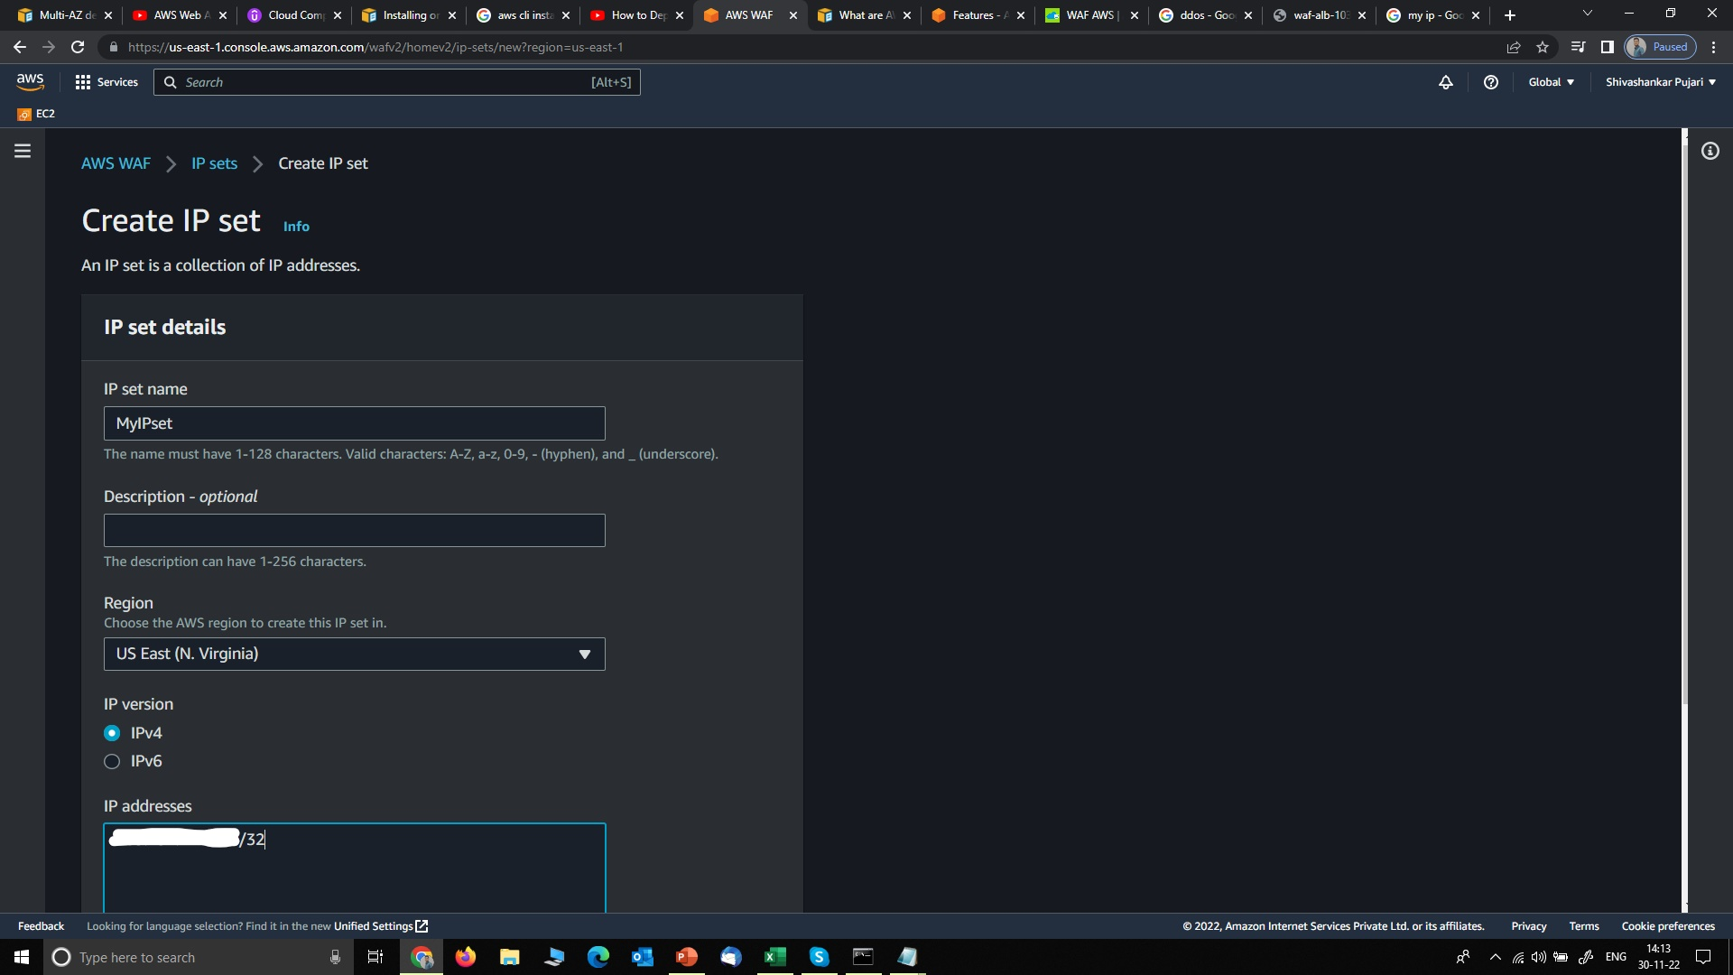
3. Create IP set for which you want to block access, here I given mine for demo

Slide 12
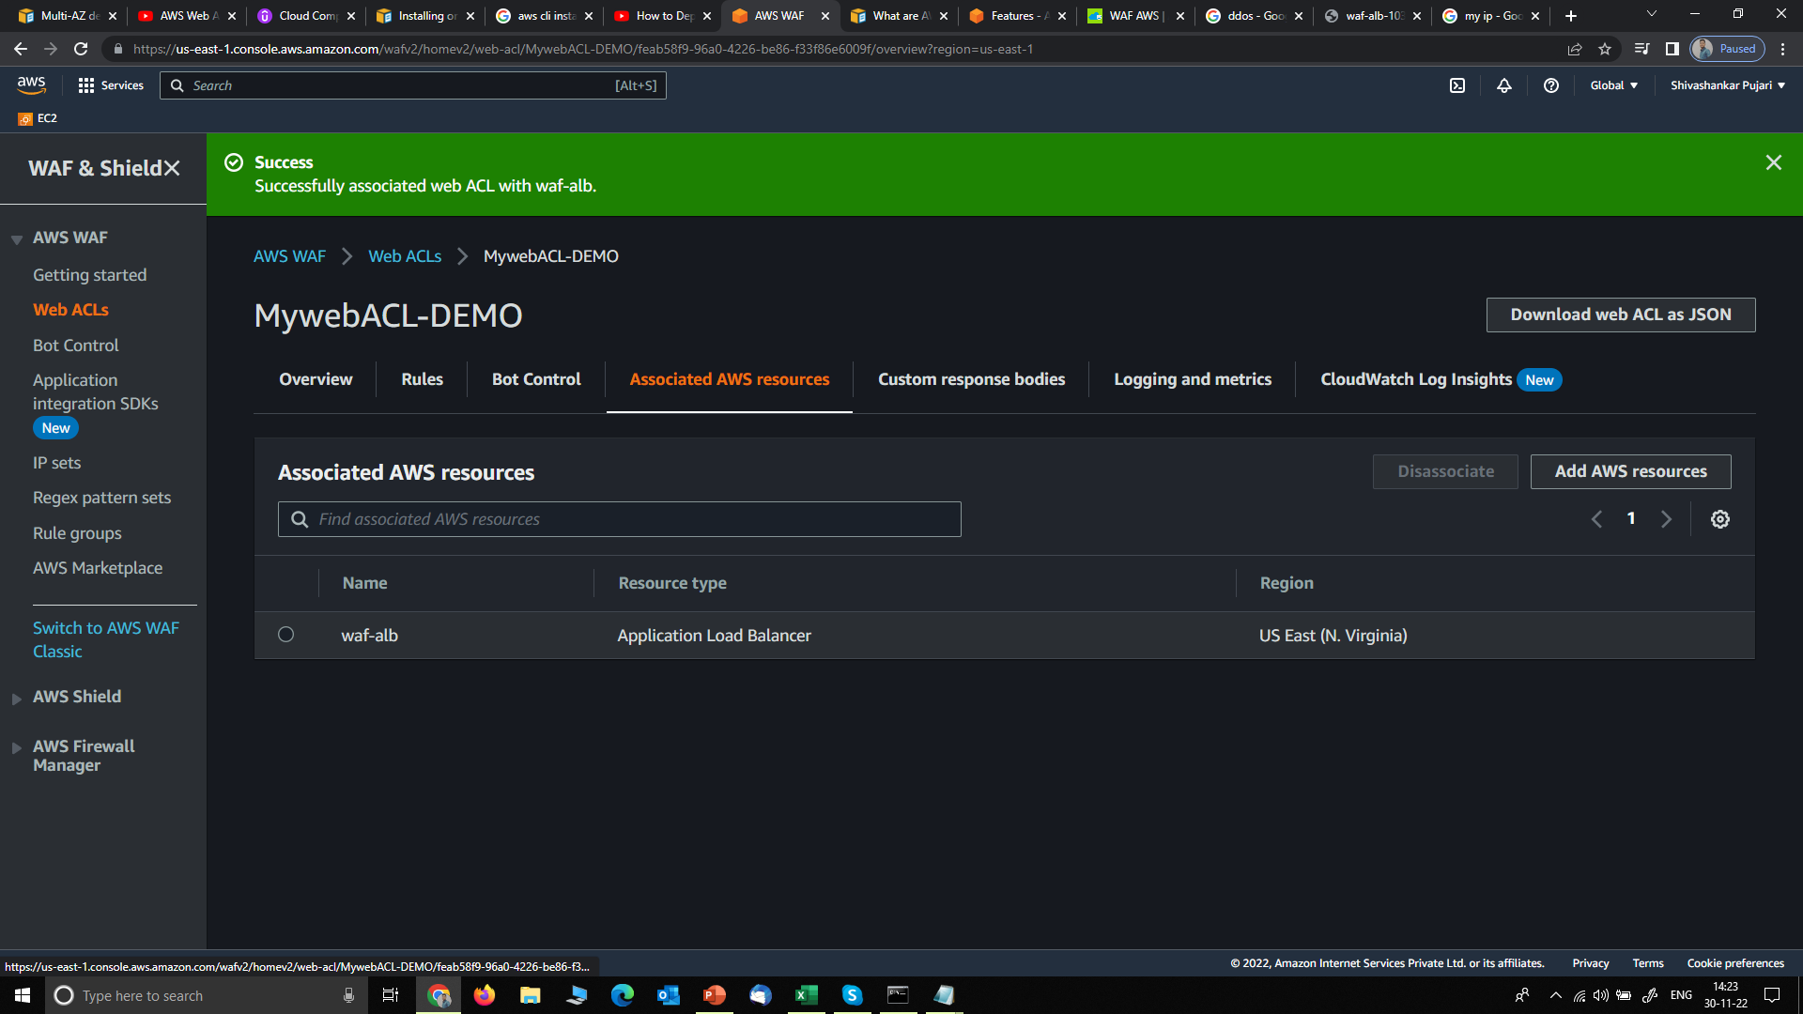
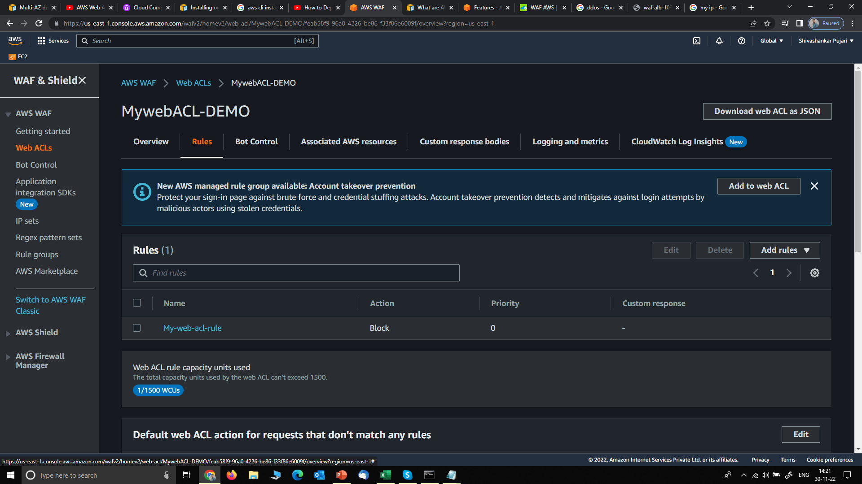
4. Rule is to block access, associated aws resources is Application load balancer

Slide 13
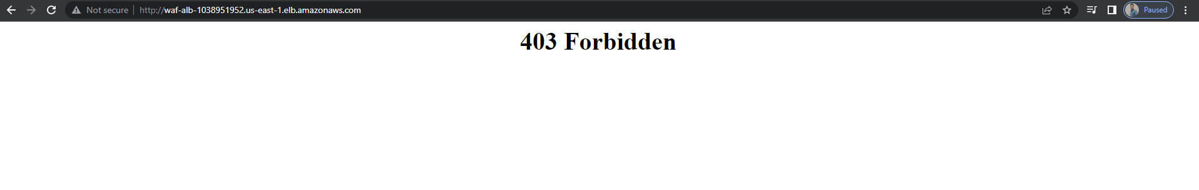
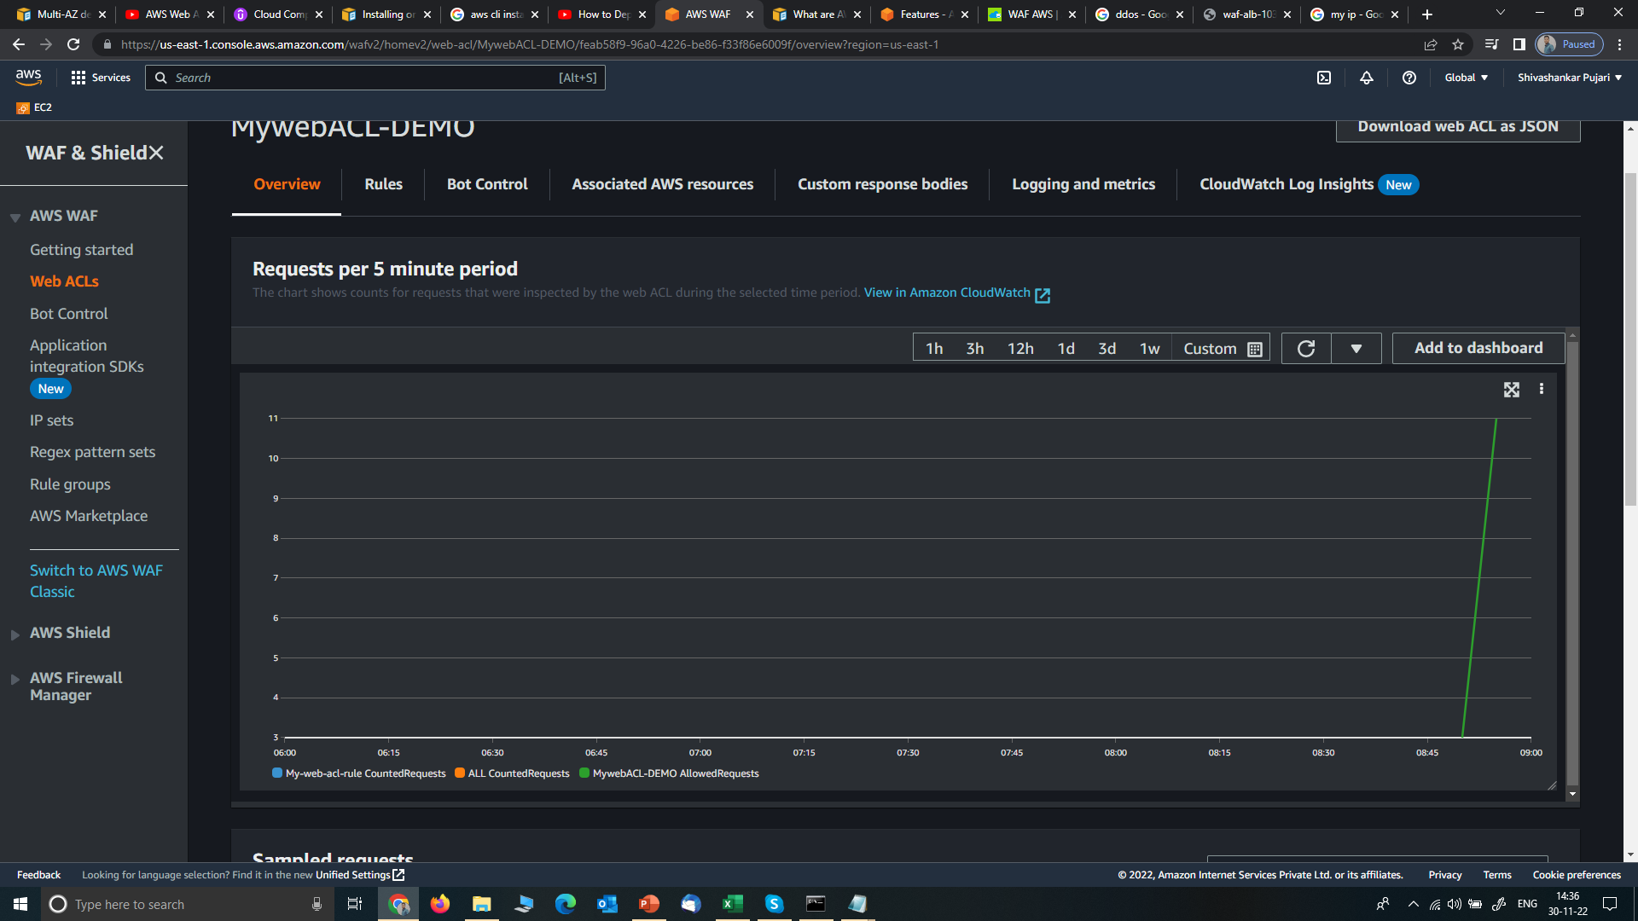
5. Tested, that it blocks request originates from my IP and shows 403 forbidden

